Slide 1
Ankita Sharma
DISCOVERIES

Slide 2
01
02
03
About Me
How I Want To Be Perceived
What Kind Of People Do I Want To Enjoy My Portfolio
Table of Contents
04
My Unique Voice & Tone - My Unique Personality That Will Shine Through My Portfolio

Slide 3


01:
About Me

Slide 4
Ardent Learner
About Me
Creative Thinker
Web Development
1
3
2

Slide 5
UX Design Enthusiast
And Still Going Strong!
About Me
4

Slide 6
02:
How I Want To Be Perceived

Slide 7
How I Want To Be Perceived
“Perception is the co-pilot to reality,” this can affect the decisions people make about you. A very big component of your success is the perception that others have of you.
You can train people to think about you the way that you want them to think about you. You need to build an Outstanding Personal Brand that reflects the best in you.

Slide 8
How I Want To Be Perceived
I Want to shape my Personal brand as:
Creator
Tough
Strategic
Confident
Active Listener
Driven
Successful
Risk Taker
Team Player
Compassionate & Approachable

Slide 9
03:
What Kind Of People Do I Want To Enjoy My Portfolio

Slide 10

What Kind Of People Do I Want To Enjoy My Portfolio
“How you climb a mountain is more important than reaching the top”. The world of work is changing. Sometimes, it can feel like finding fulfilling work is just a series of difficult choices. Striking a balance between clear and concise, requires planning.
Designers should tailor portfolios to a specific audience—a.k.a. the people they want to work with and the industries they want to work in.

Slide 11

I envision “UX Design” as a desirable career path. I have the very specific ambition to work with Interaction Designers, UX Researcher, Information Architect, and Experience Strategist.

Slide 12
04:
My Unique Voice & Tone - My Unique Personality That Will Shine Through My Portfolio

Slide 13
My Unique Voice
“People buy from people they like, know, and trust based on a relationship cultivated over time”. Personality refers to the human characteristics, emotions, and attributes embodied by a brand.
TONE
The Tone of voice is the expression and embodiment of your brand’s personality, beliefs, and values—the person behind the brand. Your tone is not only about how you speak, but also the words you use and how you use them (i.e., the cadence and rhythm, velocity, and length of your speech). Our voice doesn’t change much from day to day, but our tone changes all the time.
VOICE
Think of the Voice you use every day, it exists and is part of your personality and energy. Think of the words you use and how you use them. Consider the tenor, pitch, and velocity of your voice.

Slide 14

My Voice is “Community-driven”.. My voice guides the tone and personality of all my visual and verbal communications. It informs everything I express through Words and Pictures.

Slide 15
My Unique Personality
Personality
My Voice
My Tone
Open
Bold
Original
Positive & Optimistic
Direct & Plainspoken
Clear
Natural & Genuine

Slide 16
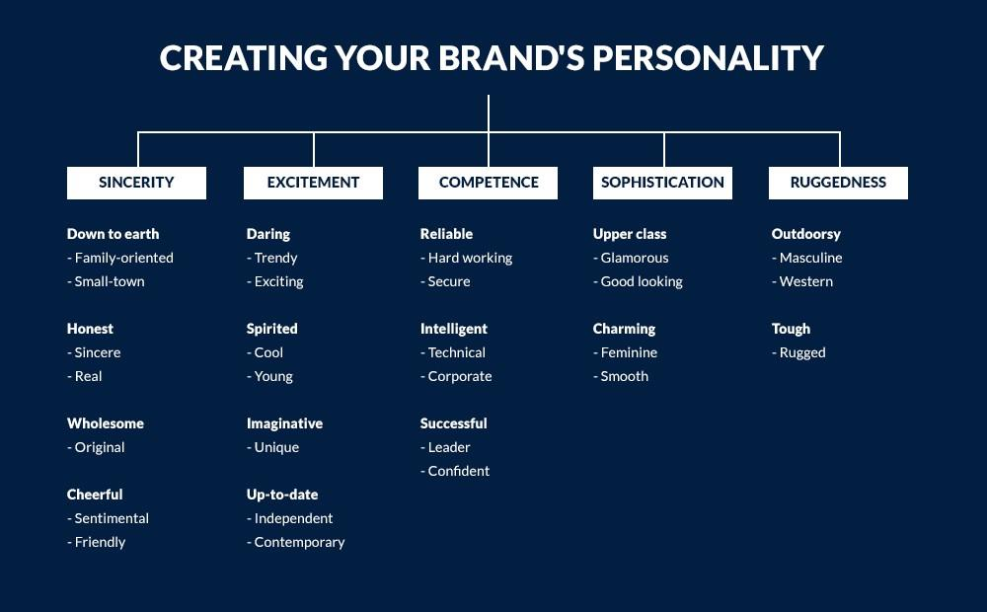
Personality That Will Shine Through My Portfolio

Slide 17


Thanks!
Do you have any questions?
ankitasharma81@hotmail.com
Please keep this slide for attribution.

